Slide 1
Final Project Presentation
Adam Nolan, Nathan Campbell, Thomas Smithers, James Hanaphy, Yejin lee
2021 Team Project

Slide 2
CONTENTS
01
02
03
04
Project Problems
Implementation
Experience with clients
Conclusions
- Project Problem 1 Identify User Requirements
- Implementation 1 Successes and Synergies
- Challenges, benefits, etc.
- Conclusions to the Project 1 Benefits and Downsides
- Project Problem 2 User Requirements and Brief Design
- Implementation 2 Issues and their Resolution
- Conclusions to the Project 2 Different Approach?
- Implementation 3 How Was Testing Undertaken?

Slide 3
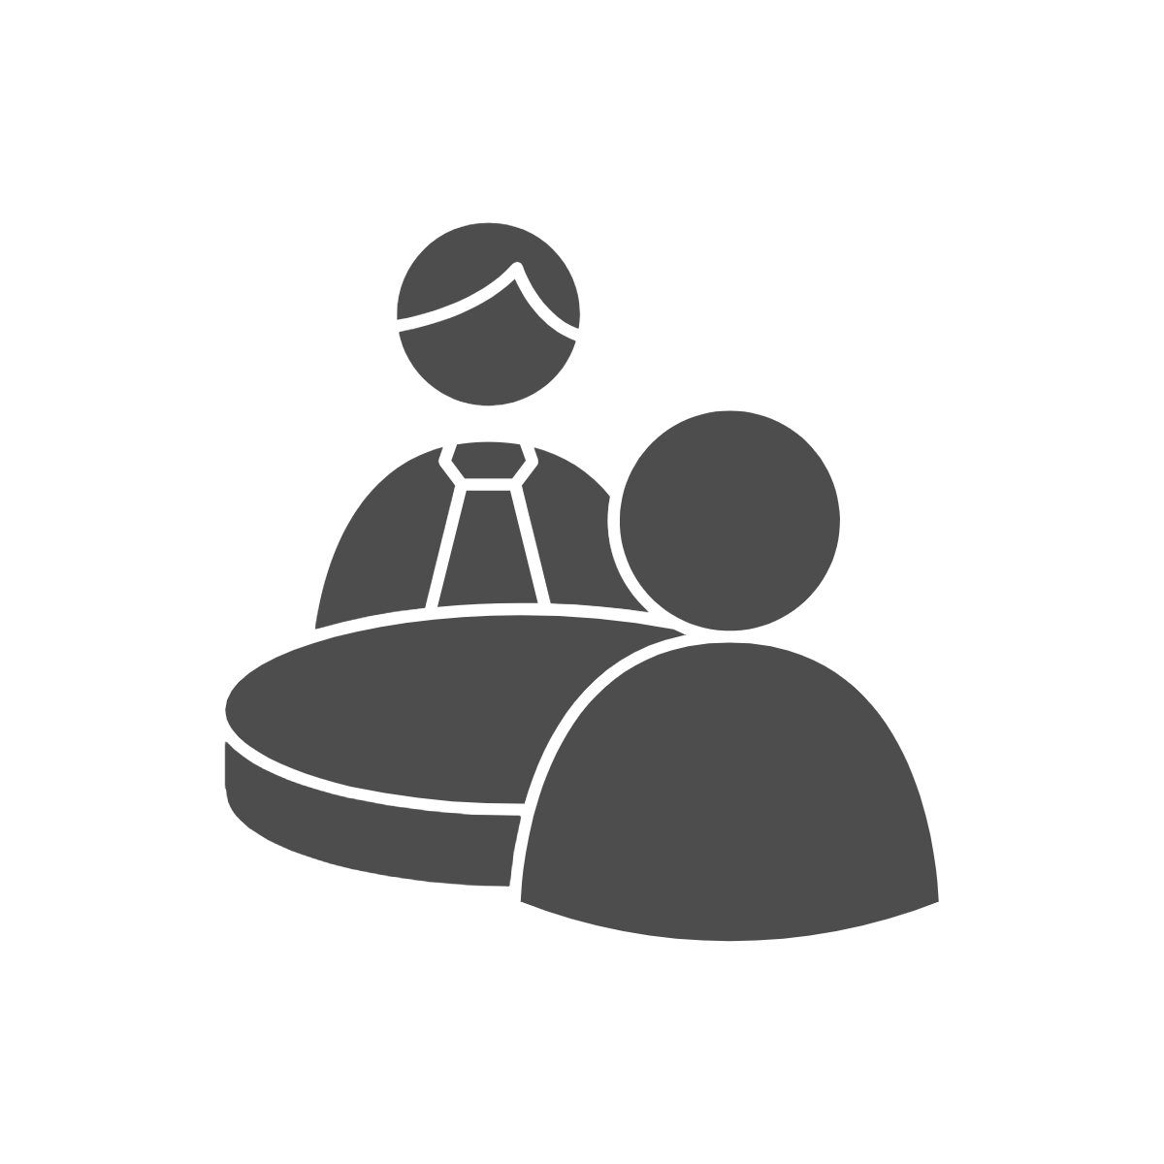
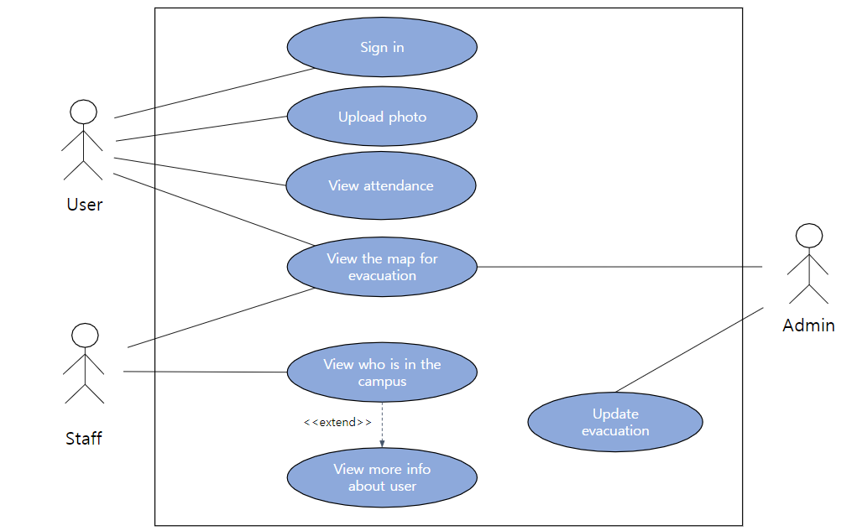
Project Problem 1 Identify User Requirements
consultation
User Requirements
01
User Requirements were identified through consultation with our clients

Slide 4





Project Problem 2 User Requirements and Brief Design
Brief Design Overview:
01
Log in capabilities for general users and staff
Attendance viewer that can show attendance of every person
Fire Escape video player
QR Code Scanner that checks the app’s database
A Database that stores User_ID, User_name, and another that can store/check email and password

Slide 5
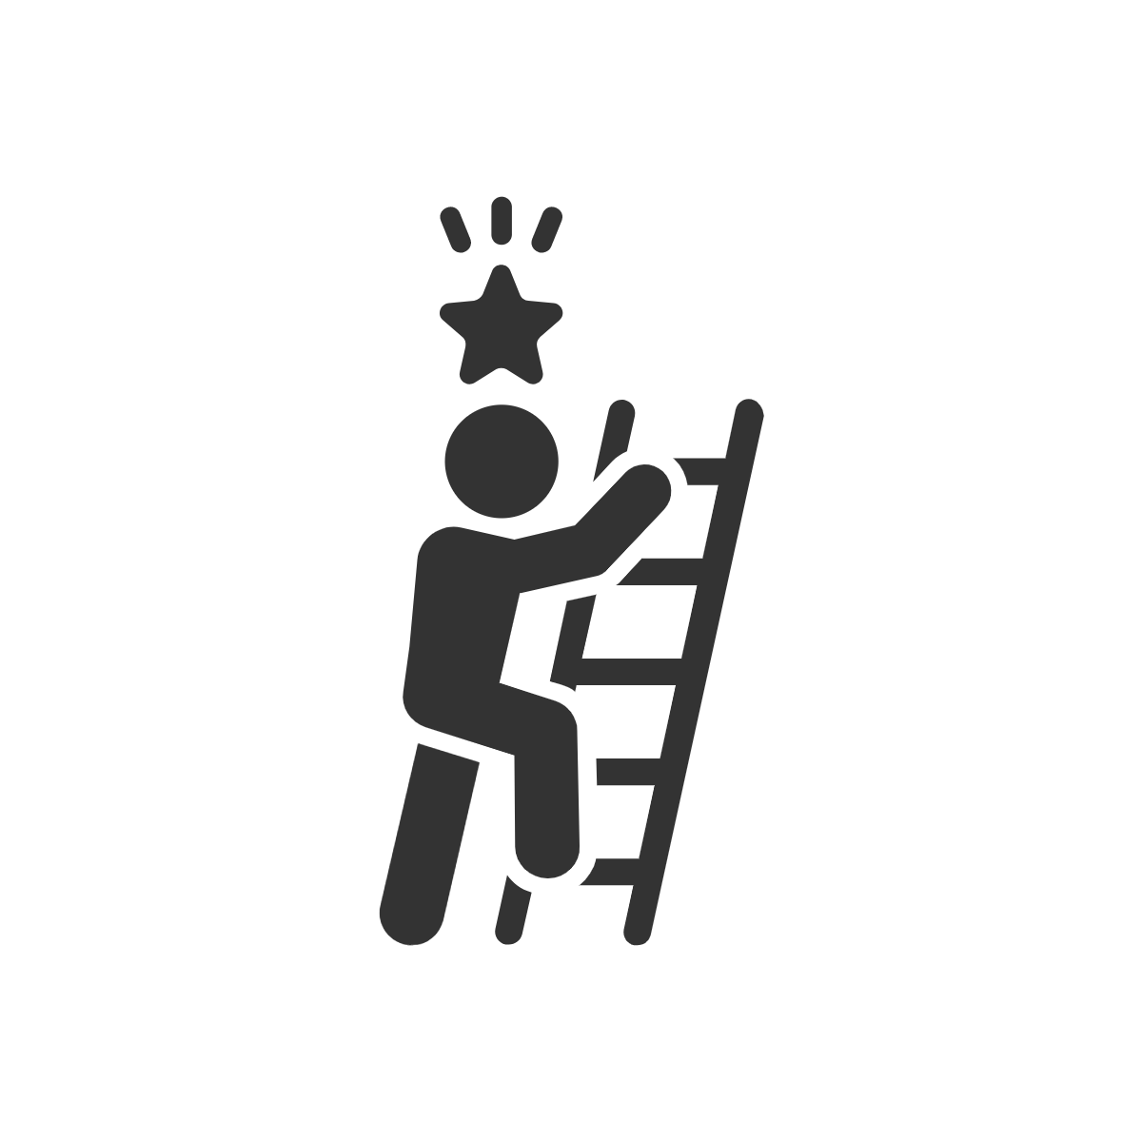
Implementation 1 Successes and Synergies
02
Implementation
Implementation 1 Successes and Synergies
Implementation was reasonably successful
Over half of the functionality was implemented smoothly
The other half were caught in testing and iterated on

Slide 6
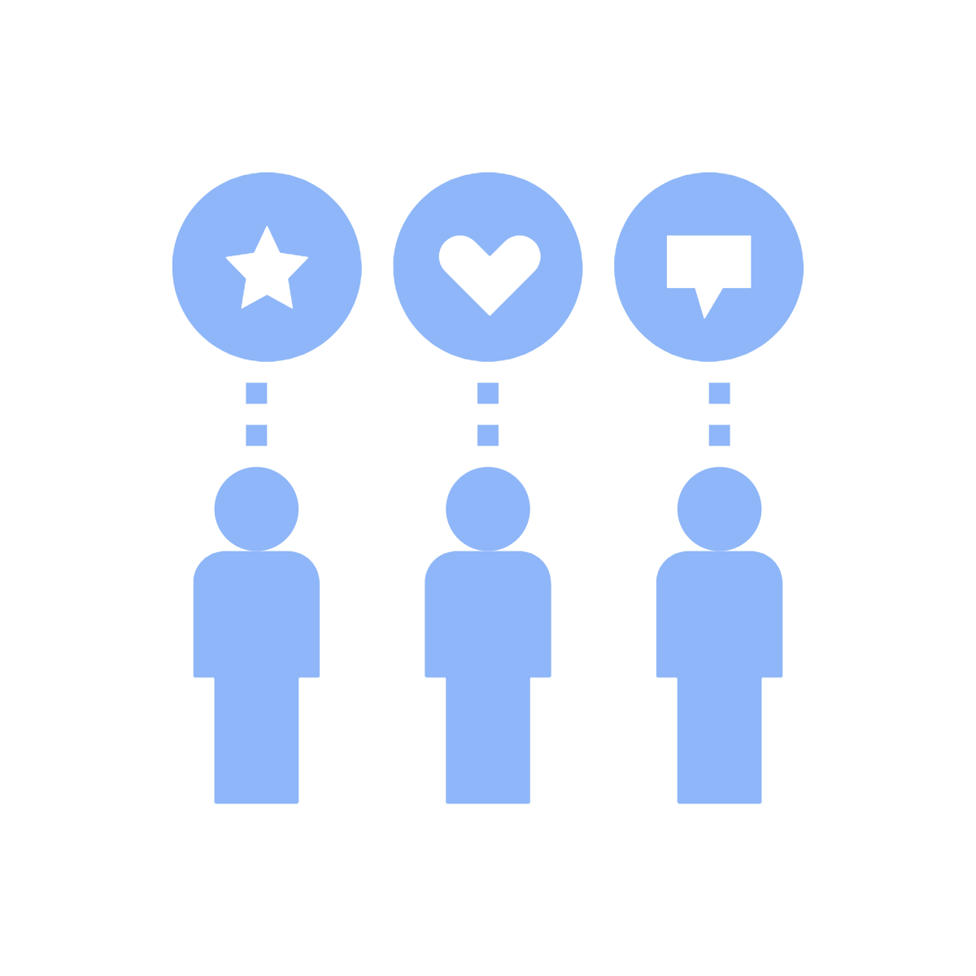


02
Implementation
Implementation 2 Issues and their Resolution
We had an issue with available skillset in the group
An issue with different time zones
An issue with arbitrary meeting times
This was resolved by us evaluating what we could do and assigning the appropriate roles
Resolved by having meeting times coincide with everyone
This was resolved by allocating weekly time-slots to hold meetings
Notes:
We had an issue with available skillset in the group
This was resolved by us evaluating what we could do and assigning the appropriate roles
An issue with different time zones
Resolved by having meeting times coincide with everyone
An issue with arbitrary meeting times
This was resolved by allocating weekly time-slots to hold meetings

Slide 7
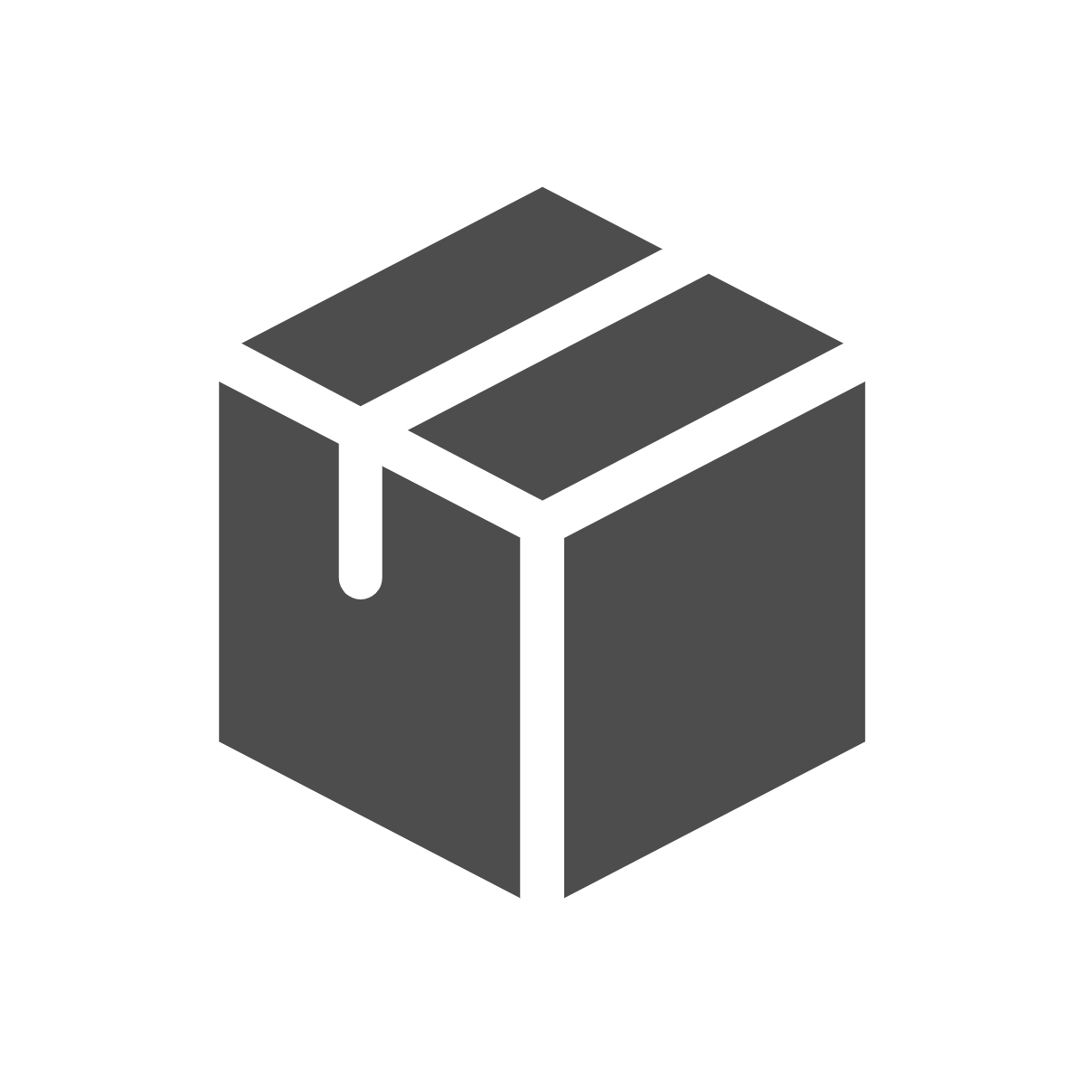

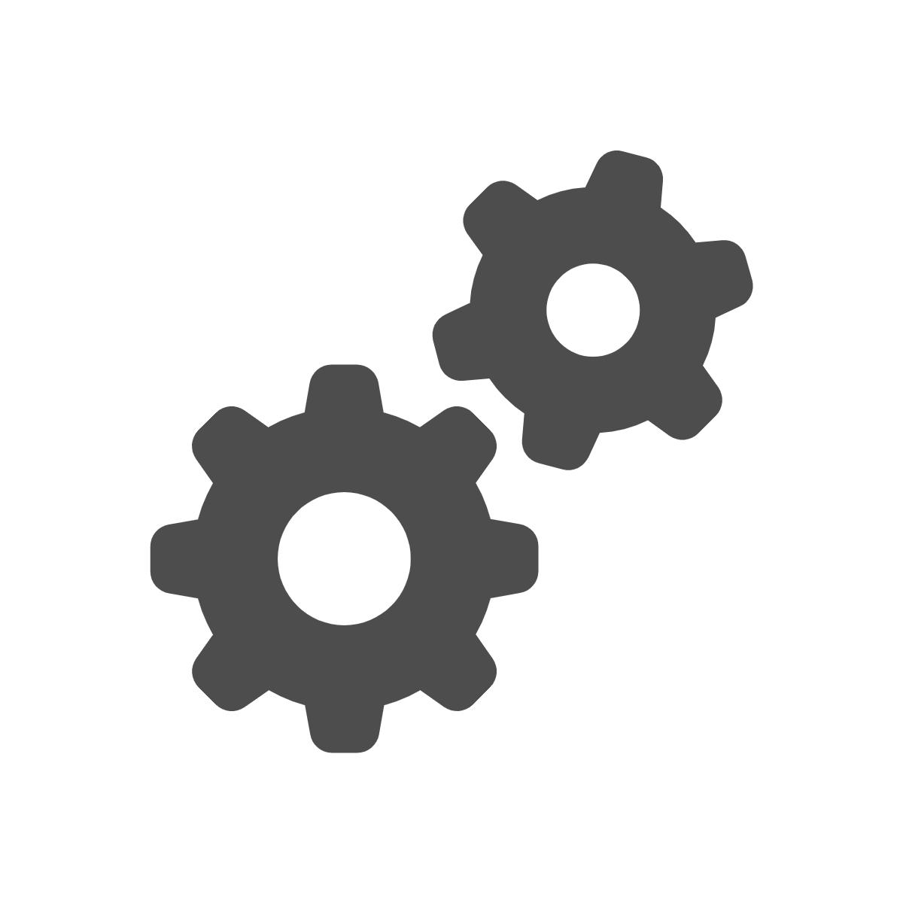
02
Implementation
Implementation 3 How Was Testing Undertaken?
The Black Box testing relates to the functional testing of the software, the tester is testing the external functions of the program rather than the actual code itself. As such it is well suited for the general team, as they use the app without having to know the details behind the programming. They note any issues and they are reported back to the lead tester. Examples would be page changes to correct locations, button functions are correct. Feedback from text field inputs, the visual aspects of the app.
The White Box testing is more suited for the lead tester and the lead programmer, it is testing with the knowledge of the internal structure of the code and the programs software. It requires knowledge of programming and how the program was created. Errors are fixed as found or shortly after as they are identified by a team member that can directly interact with the code. Examples would be the creation of databases, the correct input and retrieval of data from that database.
Unit Testing is mainly carried out by the lead tester, as the programming starts parts can be tested on a stand alone basis. There is no need for the app to be near competition. Unit testing starts as soon as the programming allows. For example, a user login page consisting of a user input and password input section with a submit button, the test can be carried out to test that this login part functions without fail. There is no need to wait until it is implemented into the app to test it.
Notes:
We had an issue with available skillset in the group
This was resolved by us evaluating what we could do and assigning the appropriate roles
An issue with different time zones
Resolved by having meeting times coincide with everyone
An issue with arbitrary meeting times
This was resolved by allocating weekly time-slots to hold meetings

Slide 8
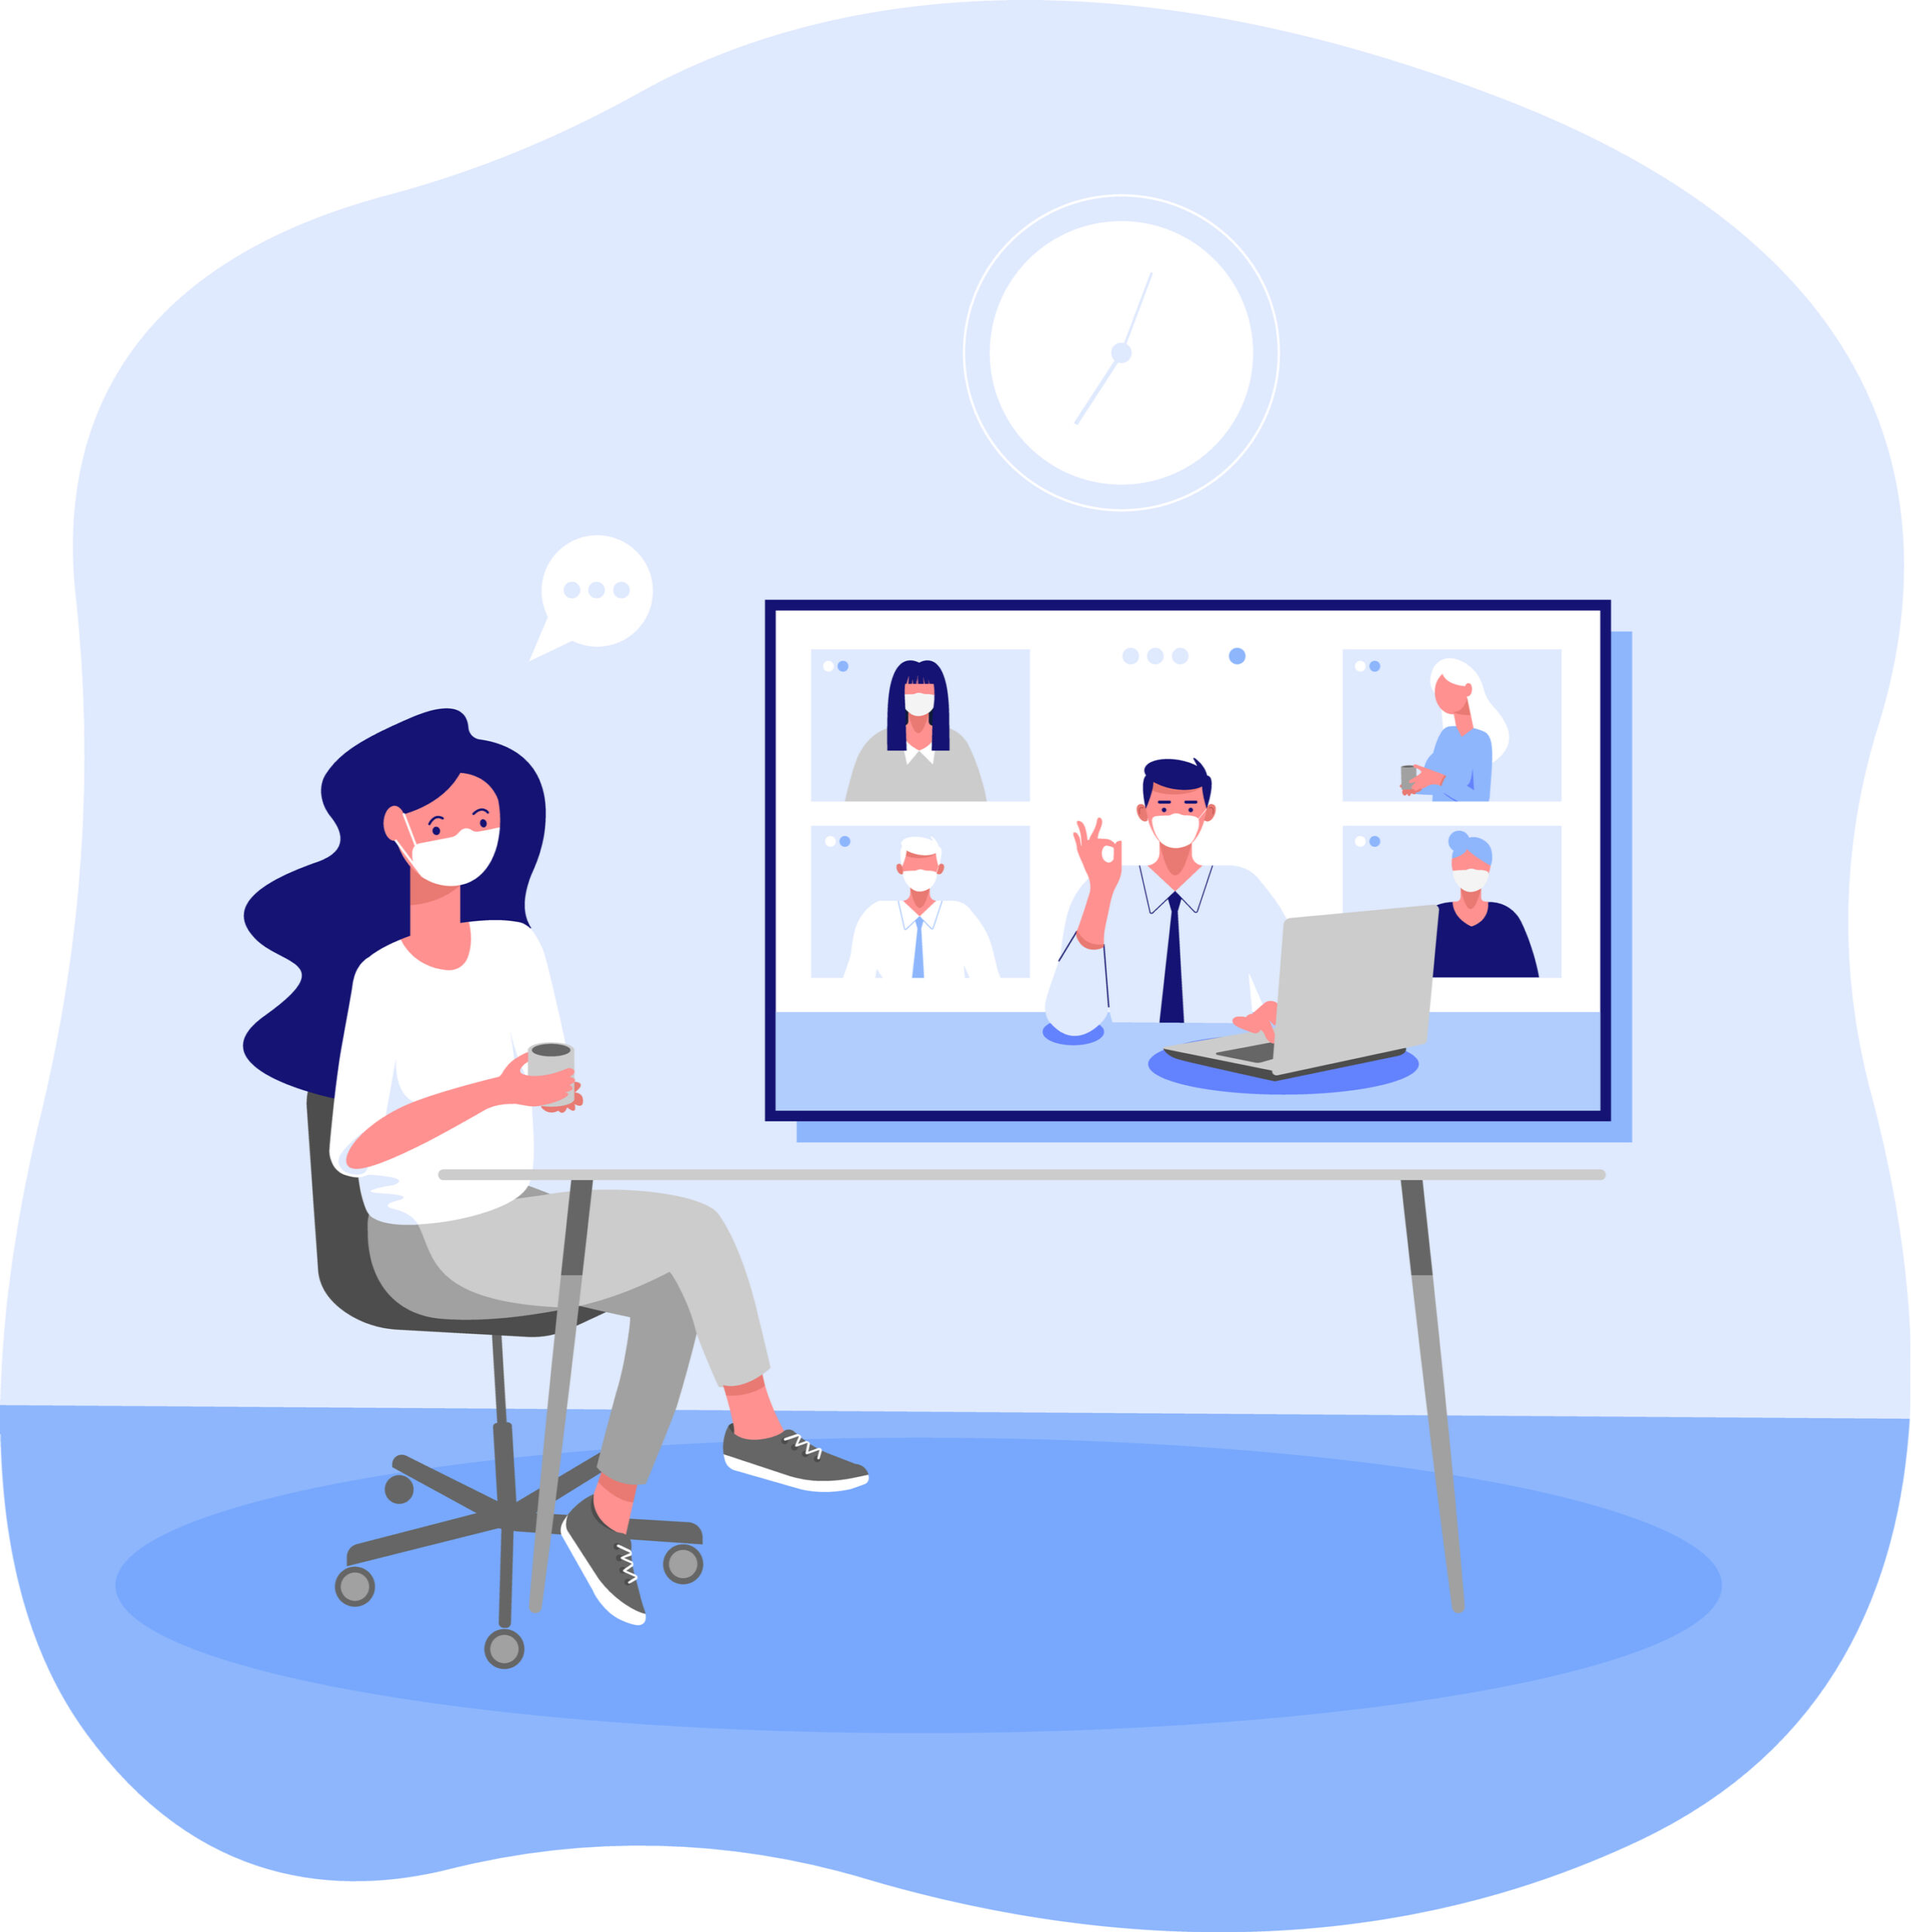
1
Challenges: Extracting user requirements from those with not a lot of digital literacy
2
Benefits: A proper insight into facilitating different user needs
What worked best: Giving open ended questions to our co-designers while talking to them in a casual manner, heaving heavy use of imagery and expressiveness in our presentations, proper discussion with our users and how they’d like to use the app
3
03
Experience with Clients
Notes:
Challenges: Extracting user requirements from those with not a lot of digital literacy
Benefits: A proper insight into facilitating different user needs
What worked best: Giving open ended questions to our co-designers while talking to them in a casual manner, heaving heavy use of imagery and expressiveness in our presentations, proper discussion with our users and how they’d like to use the app

Slide 9
Through communication with clients, we added and dropped some features including:
Attendance summaries within the code
No Facebook features
All in a menu style to facilitate those with motor difficulties
Image heavy and Colour Coding, No people inside of pictures
Used the prototyping tool of Invision
-
03
Experience with Clients2
Notes:
We had an issue with available skillset in the group
This was resolved by us evaluating what we could do and assigning the appropriate roles
An issue with different time zones
Resolved by having meeting times coincide with everyone
An issue with arbitrary meeting times
This was resolved by allocating weekly time-slots to hold meetings

Slide 10


04
Conclusions to the Project 1 Benefits and Downsides
Benefits
More members to bounce ideas off of, can allocate work amongst other members, varied skill sets allow the team to cover a wide base of requirements and needs
Downsides
reliance and dependability on others, working off of an agreed schedule rather than your own schedule

Slide 11




04
Conclusions to the Project 2 Different Approach?
Implementation would start sooner
Actually have multiple team members be fluent in the tools used for the project
Not leave most things to the last minute
Our presentations we felt were good
Follow a development cycle more rigidly rather than free form work
Notes:
Implementation would start sooner
Actually have multiple team members be fluent in the tools used for the project
Not leave most things to the last minute
Our presentations we felt were good
Follow a development cycle more rigidly rather than free form work

